Slide 1



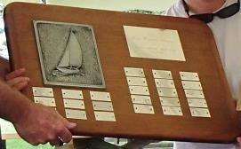
2025 Flying Scot®
North American Championships
Carlyle Sailing Association
Carlyle, IL
June 25-28, 2025
Huron-Portage Yacht Club Trophy
Presented by Fleet 20
~~~~~~~~~~~~~~~~~~~~
Best Sailed Boat with a Woman Skipper
Melissa and Eric Hemker
Ruch Creek Yacht Club, Heath, TX

Slide 2
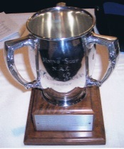
2025 Flying Scot®
North American Championships
Carlyle Sailing Association
Carlyle, IL
June 25-28, 2025
Ted & Florence Glass Trophy
~~~~~~~~~~~~~~~~~~~~~~~~~~~~~~~~~
True Love Trophy - Best Sailed Boat with
Only a Husband and Wife on Board
Tyler and Carrie Andrews
Deep Creek Yacht Sailing Association, MD

Slide 3
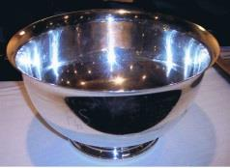
2025 Flying Scot®
North American Championships
Carlyle Sailing Association
Carlyle, IL
June 25-28, 2025
Nancy Roman Trophy
~~~~~~~~~~~~~~~~~~~~~~~~~
Best Challenger Division Sailed Boat
with a Woman on Board
Carol Claypool
Lake Norman Yacht Club, Mooresville, NC

Slide 4
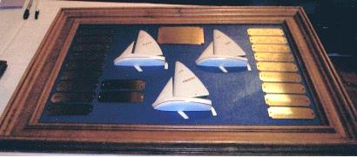
2025 Flying Scot®
North American Championships
Carlyle Sailing Association
Carlyle, IL
June 25-28, 2025
Fleet 1 Trophy
~~~~~~~~~~~~~~~~
Best Fleet in the NAC
Counting the Top 3 Finishers from One Fleet
Fleet 23, Corinthian Sailing Club
Paul Miller and Dan Kern
Tom and Melissa Miller
Robert and Nina Cummings

Slide 5
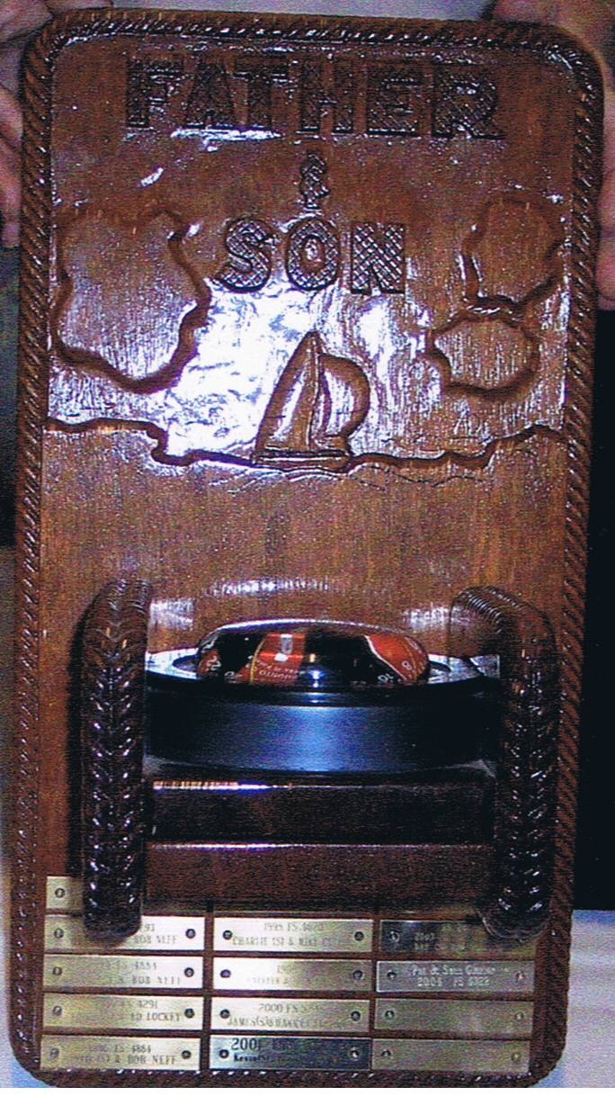
2025 Flying Scot®
North American Championships
Carlyle Sailing Association
Carlyle, IL
June 25-28, 2025
Best Sailed Generational Boat
~~~~~~~~~~~~~~~~~~~~~~~~~~~~~~~~~~~~~~~~~~
Best Finish by a team who are from multiple generations of the same family – Parent/Child, Grandparent/Grandchild, unt or Uncle/Niece or Nephew
Tuomas and Annika Sandholm
Moraine Sailing Club, Portersville, PA

Slide 6
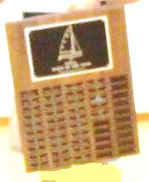
2025 Flying Scot®
North American Championships
Carlyle Sailing Association
Carlyle, IL
June 25-28, 2025
Fleet of the Year Award
~~~~~~~~~~~~~~~~~~~~~~~~~~~~~~
Outstanding Fleet for the 2024-2025 Year
Fleet 118, Birmingham Sailing Club
Stan Graham, Fleet Captain and Sally Morriss

Slide 7
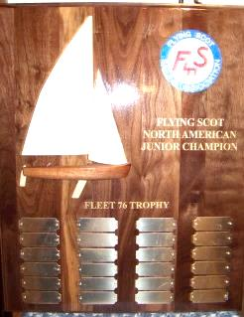
2025 Flying Scot®
North American Championships
Carlyle Sailing Association
Carlyle, IL
June 25-28, 2025
Fleet 76 Award
~~~~~~~~~~~~~~~~~~~~~~~~~~~~~~
Best Sailed Boat in the Juniors Championship
Brian and Greg Olsen,
Rush Creek Yacht Club, Heath, TX

